Slide 1
Youtube song video dashboard

Slide 2
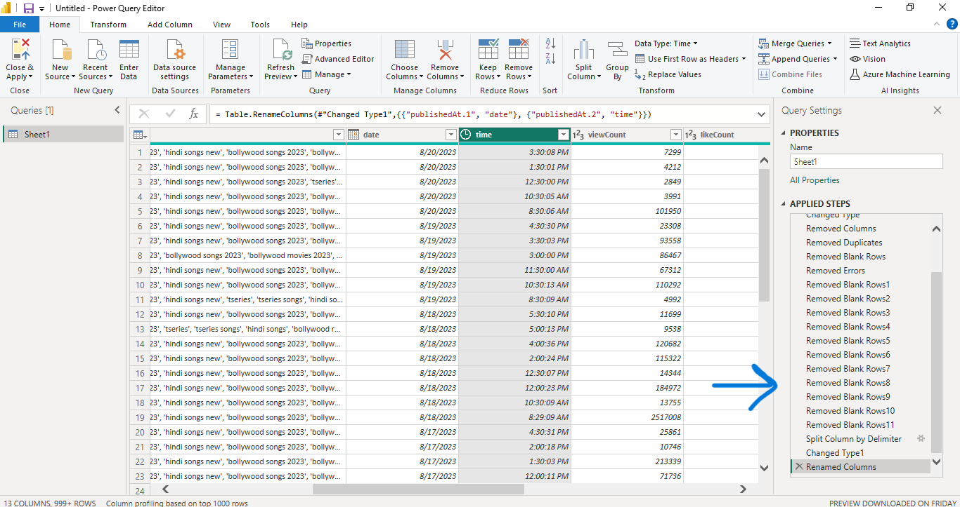
1. Data Cleaning and Preparation: - Clean and preprocess the dataset, handling missing values or outliers. - Convert relevant columns to appropriate data types.

Slide 3
Clustered column chart for:
2. Exploratory Data Analysis (EDA):
- Explore patterns and distributions in view counts, like counts, and comments.
Identify trends in the popularity and engagement of YouTube song videos.
3. Content and Channel Analysis:
- Analyze the distribution of videos across different channels.
- Identify popular tags and their correlation with view counts
Line chart for:
4. Temporal Trends:
- Explore how YouTube song video metrics vary over time.
Identify peak publishing times and their impact on engagement.
Area chart
5. User Engagement Insights:
- Investigate relationships between likes, comments, and views.
- Identify factors influencing user engagement with YouTube song videos.

Slide 4
Thank you
Yasmin mohamed
yasmin207030@gmail.com

